Slide 1
C# ASP.NET MVC
Lesson 2: Authentication and Authorization

Slide 2

Agenda
Security?
Authentication and Authorization
Authentication Overview
Types of Authentication
ASP.NET Identity
Authorization Overview
Roles
Claims

Slide 3
Security
Must be done. Not a lot of fun.
ASP.NET Web Forms had more built in security than ASP.NET MVC does
Automatic HTML encoding to prevent XSS
ViewState encrypted & validated to prevent tampering with POST of forms
Event validation to prevent injection attacks, and invalid POST values
ASP.NET MVC gives you more control / customizability, so more responsibility
‘Never, ever trust any data your users give you. Ever.’
Notes:
The most important skill of programmers is not

Slide 4
Authentication And Authorization
Authentication and Authorization is not the same thing
Authentication is used to prove user identity
Logging in with a username and password
Authorization is used to prove user access
A user having admin access
Notes:
The most important skill of programmers is not

Slide 5
Authentication
Overview
Require user to prove identity
Able to secure controller actions via attributes
[Authorize], [AllowAnonymous],ect
Filters can be registered at the global level
/App_Start/FilterConfig.cs
Redirects handled by OWIN (Open Web Interface for .NET) middleware
Cookie-based authentication
Can be seen in /App_start/Startup.Auth.cs

Slide 6
Authentication
Types Of Authentication
Individual User
Typically stored in database, or authenticated via third party (such as Facebook login)
Windows Authentication
Uses your domain account to authenticate, typical for intranet applications
Work or school accounts
Authenticated against a domain, using LDAP, Azure Active Directory, or O365

Slide 7
Authentication
ASP.NET Identity
Comes out of the box with MVC
Models/IdentitiyModel.cs
Includes 3 packages, Microsoft.AspNet.Identity.EntityFramework, .Core, and .OWIN
Roles and Claims based Authorization
Default tables are AspNetRoles, AspNetUserClaims, AspNetUserLogins, AspNetUserRoles, AspNetUsers

Slide 8
Authentication
ASP.NET Identity
Default Model can be extended
Can leverage OAuth and OpenID
Open standards for authentication using trusted sites, providers
OAuth requires you to register your application with the trusted site
You will be provided an application client id and secret
Can be seen in commented code in Startup.Auth.cs

Slide 9
Authorization
Overview
Verifying what the user can do
Done via Roles and Claims
Role based authorization removes micromanaging of users
Access is driven via role, instead of per user
Allows for different access lists across environments, and easy to grant roles to users

Slide 10
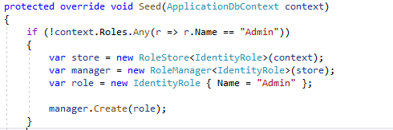
Authorization
Roles
Individual roles can be created (or seeded at start up, similar to any Entity type)
[Authorize] attribute can be used to require role membership
[Authorize(Roles="Admin")], ect

Slide 11
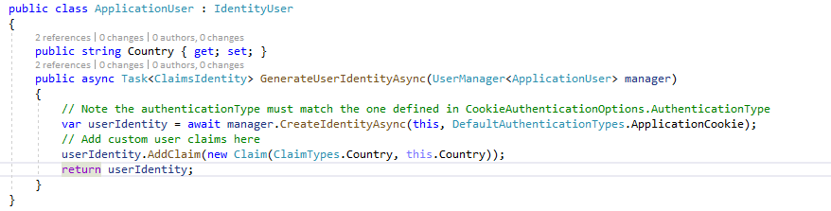
Authorization
Claims
Defining traits of a User
Date of Birth on a Drivers License is a "claim"
Claims are registered on the application user model
Default constructor takes two strings
ClaimsType is just a class of a collection of default strings of different claims types

Slide 12
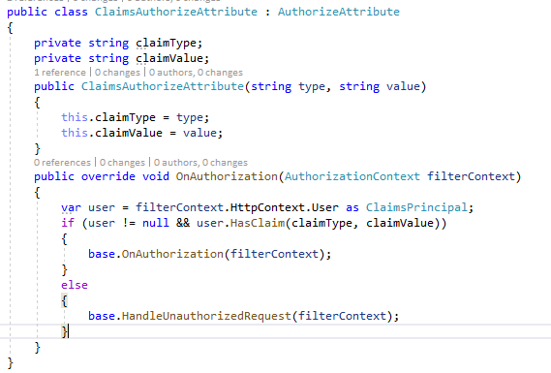
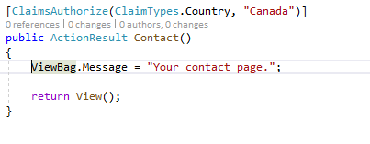
Authorization
Claims – Creating a ClaimsAuthorize Attribute
Existing [Authorize] Attribute can be extended to override the OnAuthorization Call back

Slide 13
Demonstration
Let’s build a default MVC app, same as before – user login, a testing framework
It’s going to be a simple music store

